Slide 1
Learning from Feedback
Conclusions vs observations
Get to the bottom (why, why, why) to find the root cause
Brainstorm potential solutions that address the root cause

Slide 2
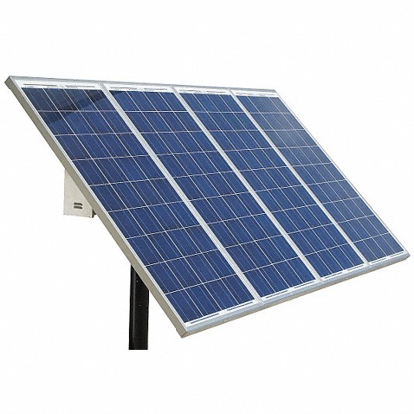
Hotel Owner in Delhi
I need to add solar panels to my hotel roof
This is a conclusion and somewhere hiding underneath this is the problem that is the source of this need
Our challenge is to uncover the origin

Slide 3
Keep on asking why all the way to the root cause!
Why do you need solar panels?
I need to have electricity all the time?
Why do you need electricity all the time?
Guest complain when the lights go out and the air conditioners and televisions don’t work
Now I think it is fairly clear why the guests are complaining, but we don’t yet know WHY the electricity is turning off. So…
Why does the electricity turn off?
Rolling blackouts by the electricity utility

Slide 4
Rolling Blackouts is the root cause for the Hotel Owner
The real root cause is even deeper (demand for electricity exceeds generating capacity of the grid)
But for purposes of solving the problem for the hotel owner we’ve dug deep enough for now

Slide 5
Now we need to ask questions that will help us define a viable solution
If the blackouts occur at night, then we know that solar panels won’t solve the problem. So let’s ask…
When do the blackouts occur?
Varies a lot, often in the afternoon and evening when everyone is running their air conditioners. Sometimes we lose power in the middle of the night. We never know when the power is going to fail.
So now we know that solar panels don’t solve this problem

Slide 6
Brainstorm ideas to provide power when grid is down
Options for the hotel owner
Diesel generator
Batteries
Conservation would reduce the cost of both of these options
Options for the electric utility
Add generating capacity
Encourage conservation with real incentives

Slide 7
What else do we need to know?
Duration of outage will likely determine if battery or diesel generator is more cost effective

Slide 8
Reflections
Original statement by the Hotel Owner was that they needed solar panels. That was a conclusion that doesn’t logically follow from the problem that they were facing.
It is common for conclusions to be incorrect, so it is very important to dig down to the root cause

Slide 9
You can make troubleshooting easier!
Don’t give the conclusion! Your conclusion often doesn’t help identify the actual problem.
Examples of conclusions that don’t give useful information
The (pump, car, computer, software, etc.) doesn’t work
Switch from giving a general conclusion to giving specific observations
When I turn on the switch to activate the pump I don’t hear any sounds from the pump and the motor shaft doesn’t rotate.
Two things that you heard and saw that help identify what the problem might be
Useless information

